Slide 1
SD + DE
2023
Mobile Applications
Week X : Title week
Daan Nijs / Dries Decuyper

Slide 2
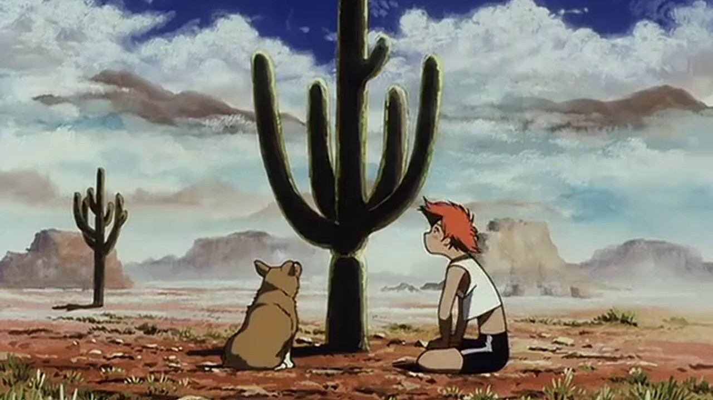
How was your summer?

Slide 3


Slide 4
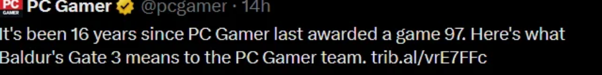
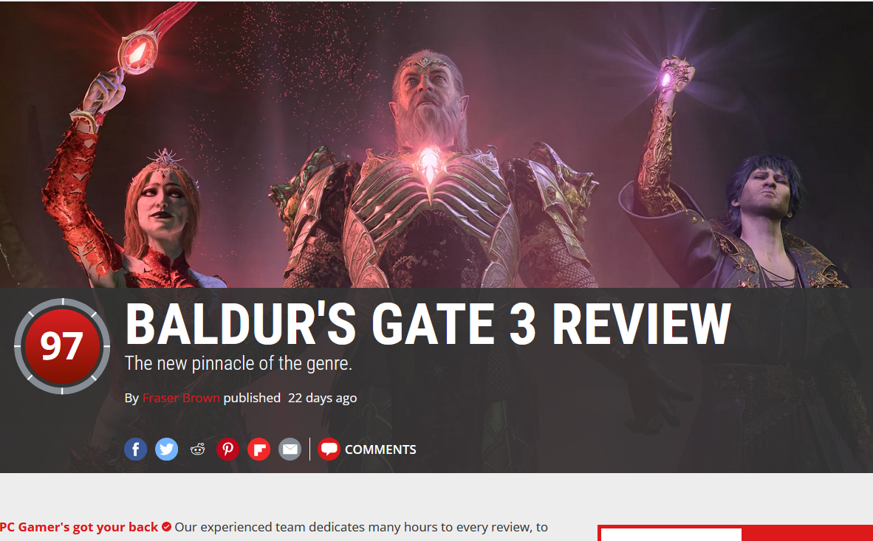
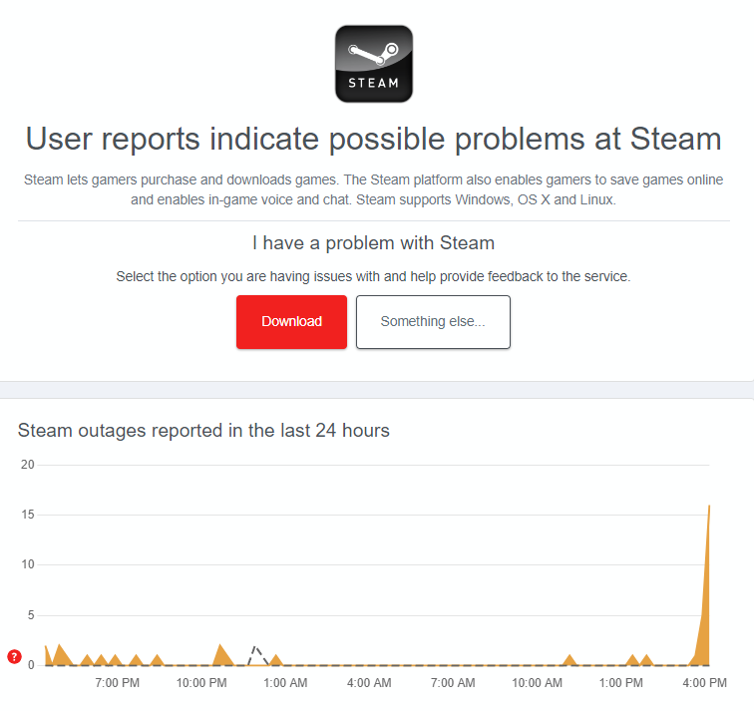
(For a day) 8th best game of all time (metacritic)
Shared 1st spot (with Disco Elysium) for best game all time on PC
At launch, 24% of people playing a game on steam were playing BG3

Slide 5

Am I bragging?
Yes, …. Kinda
Writers and artists made this game
But I still *NEED* to be proud
And so do you

Slide 6
Be proud of your s**t
“Quality is what you do if nobody is looking”
Some (or even most) of your work will never be used
Some of your work you will hate
Being proud is what works for me
It ensures you will do what needs to be done

Slide 7
SD + DE
2023
Mobile Applications
Week X : Title week
Daan Nijs / Dries Decuyper

Slide 8
Last week

Slide 9
This week
Enumerate everything you will explain
Put a “carrot”. Eg “At some point, there will be a twist”. This will keep them alert looking for the twist
End with the conclusion (“accessibility is important, and not an afterthough”)

Slide 10
Course planning : context
A list of all the weeks with topics, big arrow at where we’re at

Slide 11
Traffic lights
Green : if you’re at this point of your project this week, you’re doing fine
Orange : if you’re at this point of your project this week, you don’t have an immediate problem, but you’re in the danger zone
Red : if you’re at this point, or not even at this point, you have a really big problem. Contact me.

Slide 12
Content
Your content here

Slide 13
Next week
Ideally the slide “today” of next week’s intro slides, but can be more vague. Try to make it enticing

